Slide 1
Ethics in social media Research
SOC 2101 – Society, Environment and Engineering Ethics
Faculty: Shekh. Md. Saifur Rahman

Slide 2
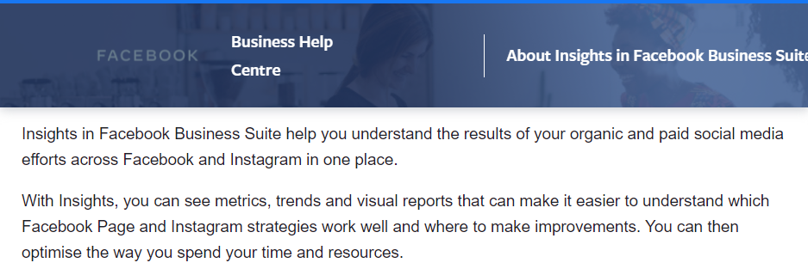
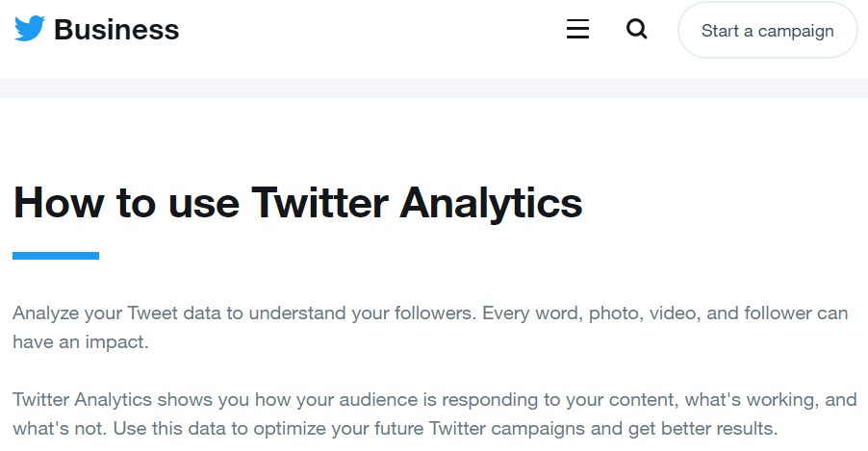
What is social media research
Any form of research that uses data derived from social media sources
using social media as a research tool (e.g., survey)
research on the activity and content of social media itself
Social media data is valuable
haven of rich, natural attitude and behavioral data

Slide 3


social media research Areas
Collecting data
Data is collected through interview, focus group, and survey methodologies
Example: a survey on diabetes related FB groups to observe how patients and their close people share information and receive emotional support
Content analysis
Facebook posts, Tweets, YouTube videos are used as a data source.
Example: behavioral patterns of drug addicted young adults on social media websites

Slide 4
Why is privacy important in social media research?
Our social media profile can impact
Our reputation Management
Control over our Life
Our freedom of Thought and Speech

Slide 5
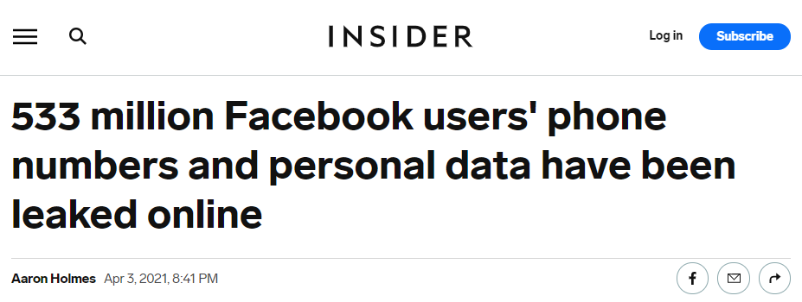
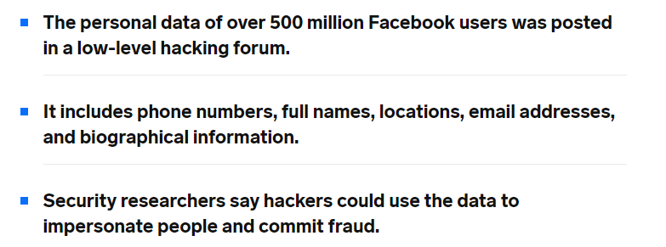
Facebook data leakage: what could be its consequence?
valuable to cybercriminals in impersonate those users or to scam them by social engineering
your credit card info can be scammed through this

Slide 6

Key concerns
Private vs. public?
Informed consent
Data ownership, Anonymity
Risk of harm
and many more…

Slide 7
Are Social media SITES Private vs. public?
depends on the online setting itself, and whether there is a reasonable expectation of privacy on behalf of the social media user (British Psychological Society 2013)
“… it is problematic for researchers to justify their actions as ethical simply because the data are accessible… The process of evaluating the research ethics cannot be ignored simply because the data are seemingly public” (boyd and Crawford 2012, p672)
Is the data of a password protected ‘private’ Facebook group can be considered public?
Is an Open discussion on Twitter using a hashtag can be considered public?
what do you think?

Slide 8
Informed consent
Ticking agreed to the terms and services is not the same as informed consent
Many users do not read those properly.
Even if the terms and services include clauses on the accessing and re‐use of data by third parties, in many cases ‘Participants’ are rarely aware of their participation.
Informed consent include the right to withdraw (the right to be forgotten)
does deleting a post or account equate with a withdrawal from research, and is a researcher aware when this happens?

Slide 9
Anonymity
Anonymity must be ensured, if there is no explicit consent
Exception: public figures acting in public capacity
Social media data is searchable
Difficult to anonymize
image of model from a professional photoshoot
vs
photo of people taking part in a public protest
which one do you think needs to be anonymized?

Slide 10
Risk of harm
More risk - needs more careful consideration
Consider vulnerability of participants
informed consent of underage person is not enough
Comments made ‘in the heat of the moment’
Using current/‘live’ data = more risk of harm

Slide 11
Ethical Framework

Slide 12
Ethical Framework
Read relevant terms, conditions and guidelines
T&C aimed at users, at third-parties wishing to use data, at you from your organization etc.
T&C may change over time
Assess
Is the data public? Are you dealing with young or vulnerable group?
Is the data sensitive (less sensitive: weather, recipes etc. more sensitive: driving offences, drug usage etc.)?
To republish
Seek informed consent
Paraphrase – Does paraphrasing acceptable in that particular research?
If it is media data – consider copyright issue.

Slide 13
Facebook emotion study

Slide 14
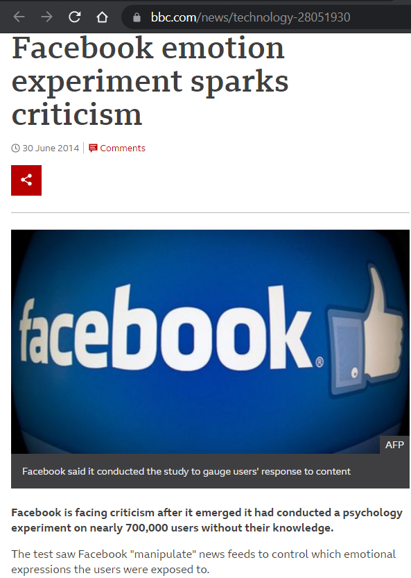
The research was conducted on 689,000 Facebook users over a period of one week in 2012.
Reduced positive contents for a group of people. Reduced negative contents for another group of people.
To investigate the common worry that seeing friends post positive content leads to people feeling negative or left out

Slide 15
case studies

Slide 16
Case study 1
Context:
The researcher wants to study how members of a mental health support forum support each others in dealing with issues, such as depression and suicidal thought. This is private forum and there is a forum admin.
Concerns:
The forum members expect privacy regarding their very sensitive data. This raises questions about the ethics of accessing data, and how to report the findings of the data if it is accessed.

Slide 17
Case study 1
Solution:
The researcher should treat this data as private. In access this data, she can seek consent of the group members with the help of forum admin, who can ask about forum members’ consent.
After getting consent to access data, there should be option for uncomfortable members to opt out. Those members should have separate safe place to use this forum as before.
If the researcher wants to republish some data, she needs to seek informed consent from each member whose data will be republished. Moreover, the data should be anonymized.

Slide 18
Case study 2
Context:
A researcher wish to identify the tone of social media postings of Olympic athletes on their Facebook and twitter profile. Those profiles are public and have many followers. Concerns:
Can those posts be considered public and can those be republished without modification?

Slide 19
Case study 2
Solution:
The sportspersons are posting using a public profile aiming to increase their reach. So, it is reasonable to consider the data public and republish is without anonymizing. Also, given that they have already a large followers, the republished data is unlikely to pose any additional potential harm on the sportspersons.

Slide 20
references
Social Media Research: A Guide to Ethics - Dr. Leanne Townsend and Prof. Claire Wallace
Ethics, Social Media Research, and Users’ Views Presentation
https://slideplayer.com/slide/13699638/

